Slide 1

Capstone project –phase b 21-1-R-21
Online Algorithms in Optical Networks Design, Analysis and Simulation.
By: Amir Amara & Fida Khoury
Supervised by: Prof. Shmuel Zaks

Slide 2
Rewind to phase 1
On-Line Algorithms
Optical Networks
What Is The Problem
Competitive Analysis

Slide 3
On-line algorithm
No prior knowledge of the input.
Can only use the input given so far.
input
New input ?
input
Offline Algorithm
Online Algorithm
Output
Output

Slide 4
Optical network
What is an optical network?
Where is our main focus?
Station 1
Station 2
Station 3
lightpath
ADM
ADM

Slide 5
What is the problem?
Each lightpath requires an ADM at each endpoint.
The lightpath’s are assigned wavelengths(colors) randomly when we receive them.
Station 1
Station 2
Station 3

Slide 6
Optimal solution
The optimal solution is an offline algorithm.
Non conflicting lightpaths can share an ADM on one endpoint.
The lightpaths are given in-advance.
We can assign colors in an optimal way.
Station 1
Station 2
Station 3

Slide 7
MINADM solution
minADM is an online algorithm.
Color lightapths online while receiving them.
Coloring procedure optimizing.
Station 1
Station 2
Station 3

Slide 8
minADM Flow chart
Reducing ADM in optical network
Lightpath p with endpoints u & v
If a chain of lightpaths has a free ADM in node u or v or both and assigned to color C while not conflicting with the current lightpath
yes
We can assign the presented path p to the same color C
Lightpath p assigned to color C
Lightpath p assigned to color C3
no
If P1 is a chain of lightapths that has a free ADM in u and assigned the color C1. P2 is a chain of lightpaths that has a free ADM in v and assigned the color C2 while not conflicting with the current lightpath
Then there is no chain of lightpaths ends with u or v therefore, p will be assigned to a new color C3.
yes
Then the lightpath p tries to connect to any of the chains P1 or P2, both ways are correct
Lightpath p assigned to color C1 or C2 randomly
no

Slide 9
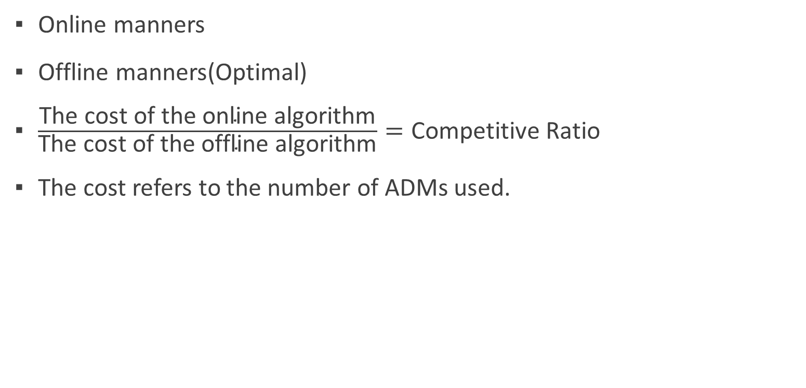
Competitive Analysis
Online manners
Offline manners(Optimal)
$\frac{\text{The} \text{cost} \text{of} \text{the} \text{online} \text{algorithm}}{\text{The} \text{cost} \text{of} \text{the} \text{offline} \text{algorithm}}=\text{Competitive} \text{Ratio}$
The cost refers to the number of ADMs used.

Slide 10

The bounds of our analysis
Ring and Line topologies.
C-Ratio bound for the ring topology : $\frac{7}{4}$= 1.75
C-Ratio bound for the Line topology : $\frac{3}{2}$= 1.50

Slide 11
Earlier challenges
Which technologies to use?
How to simulate?

Slide 12


Which technologies to use?
A hard to grasp concept
No terminal results
Easy visualization
React: frontend JS library
D3: for data visualizations using SVG
+

Slide 13
How to simulate?
Optimal solution in a reasonable time.
First create the optimal network alongside with the lightpaths and the optimal connections between the lightpaths.
Calculate the amount of ADMs used to construct the optimal solution
Start feeding the lightpaths to the online version of the algorithm in an online manner, which would simulate the run of an online instance of the lightpaths.
Calculate how many ADMs were used by the online version.
Having the cost of both versions we can calculate the competitive ratio.

Slide 14
Research & Development
Testing process
Live Demo
The results of the simulator

Slide 15
Testing the simulator
Test subject | Testing plan
Create a network with the given input. | Testing if network is created by the simulation itself, the drawing of the creating depends on that. So, if we can see on the screen the ring/line that means the input has been drawn correctly.
Lightpath creation. | First of all, we printed it in the terminal, after that for bigger input we just test it by drawing it on screen (simulating the lightpath ).
Lightpath connectivity. | Our lightpaths is random so only for testing we gave it a specific endpoint and made it draw it on screen.
Ratio calculation. | For testing the calculation, we gave the function a specific input then compared if it returns the c-ratio that should be for those specific inputs.
Counting ADMs. | Checking if the test result for a specific input is equal to the actual result.

Slide 16
Final Product
Step 3
Simulate the algorithm
Visualize the results
In average results
Step 2
Step 1
The user can also run the algorithm a number of times and see the results in average with getting the worst case result
The user inputs the number nodes in the network and the number of optimal valid chains
The user simulates the algorithm and can step over the algorithm’s steps

Slide 17
Live Demo
Let’s See the Simulator ☺

Slide 18
The simulator flow
Possible Results
Background Calculations
Get the final result of the run
Complete run
Construct the graph and lightpaths in the background
Input
+
Step over
Get the result of the run step by step
Nodes Number
Drawing the graph with the optimal chains and divide the drawing into the lightpaths
Simulate
+
optimal chains number
+
Average
Run the algorithm many times and display the average of the runs
Prepare the domain of the drawn lightpaths to be inserted one by one to the minADM algorithm
Visual togglers for the graphs
Show Buttons

Slide 19
The results of the simulator
We have conducted the simulation over a variety of different input on ring and line topologies
We have gotten results that show that in average of a large number of runs the algorithm still behaves below the bounds that we have set in both topologies.

Slide 20

Results over line topology
C-Ratio bound : $\frac{3}{2}=1.50$

Slide 21

Results over Ring topology
C-Ratio bound : $\frac{7}{4}=1.75$

Slide 22
Summary
Expectations vs Reality.
Results Discussion

Slide 23
Expectations vs Reality
Python or Javascript?
Throwback to geometry and trigonometry☺
Handling SVG.

Slide 24
Results Discussion
Surprising results.
Meeting the bounds.

Slide 25
Thank you all!
Ready for
Questions.
Special thanks to prof. Shmuel

